Slide 1

Unity 3D Basics
Mobile Game Release
SoftUni Team
Technical trainers
Software University
https://softuni.org

Slide 2

Table of Contents
1. Preparing
2. Standalone
Windows
Linux
Mac
3. Mobile
iOS
Android
4. Consoles
Xbox Series X

Slide 3
Have a Question?
sli.do
#Unity3D-Basics
Notes:
‹#›

Slide 4

Preparation

Slide 5
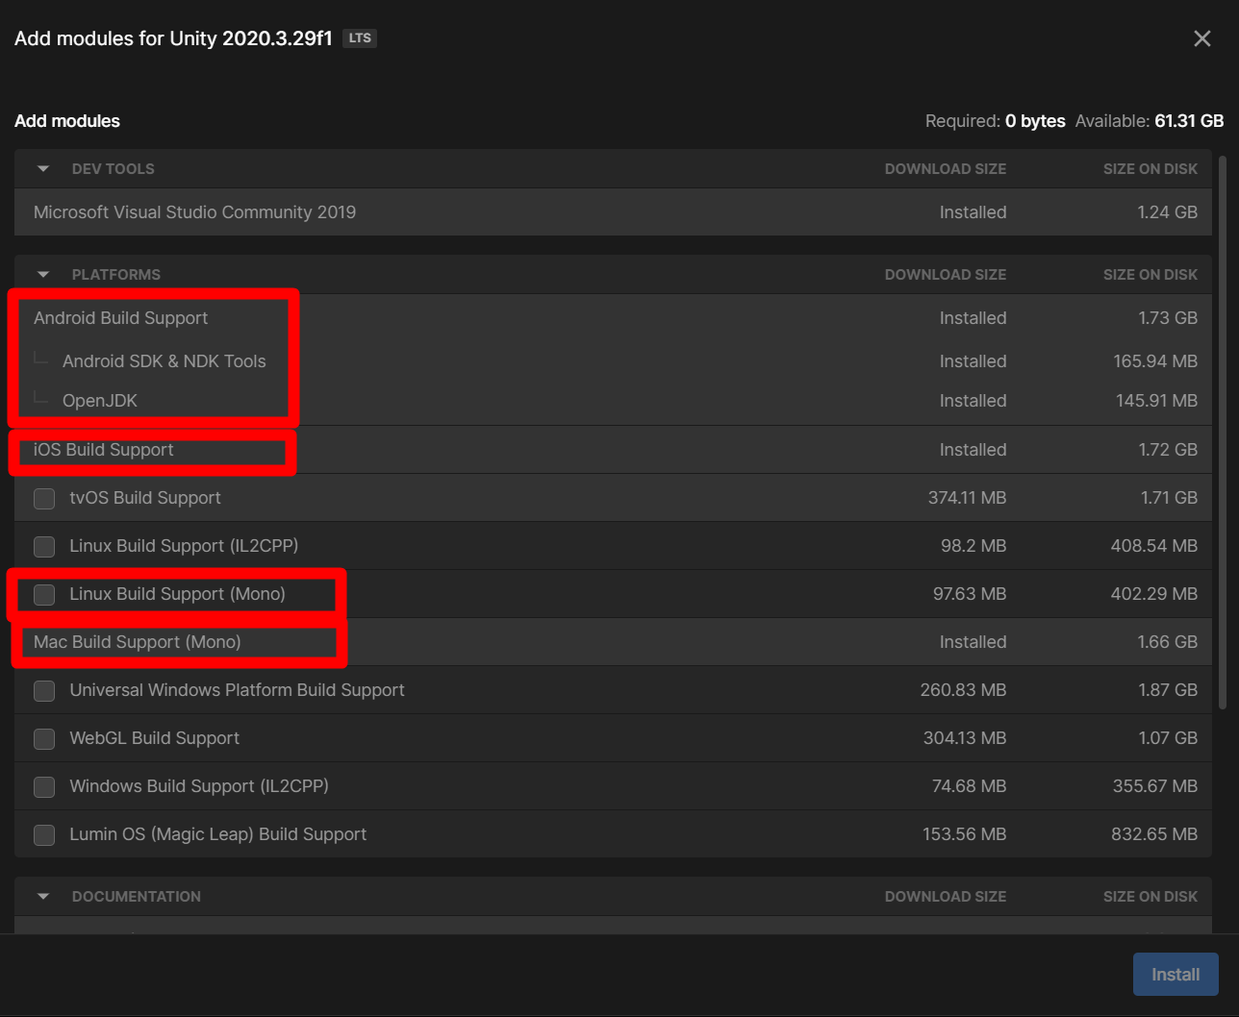
Preparation
Install platform addon
Conditional Compilation
Project Settings
Scenes in Build
Target Platform
Compression Method

Slide 6

Build

Slide 7
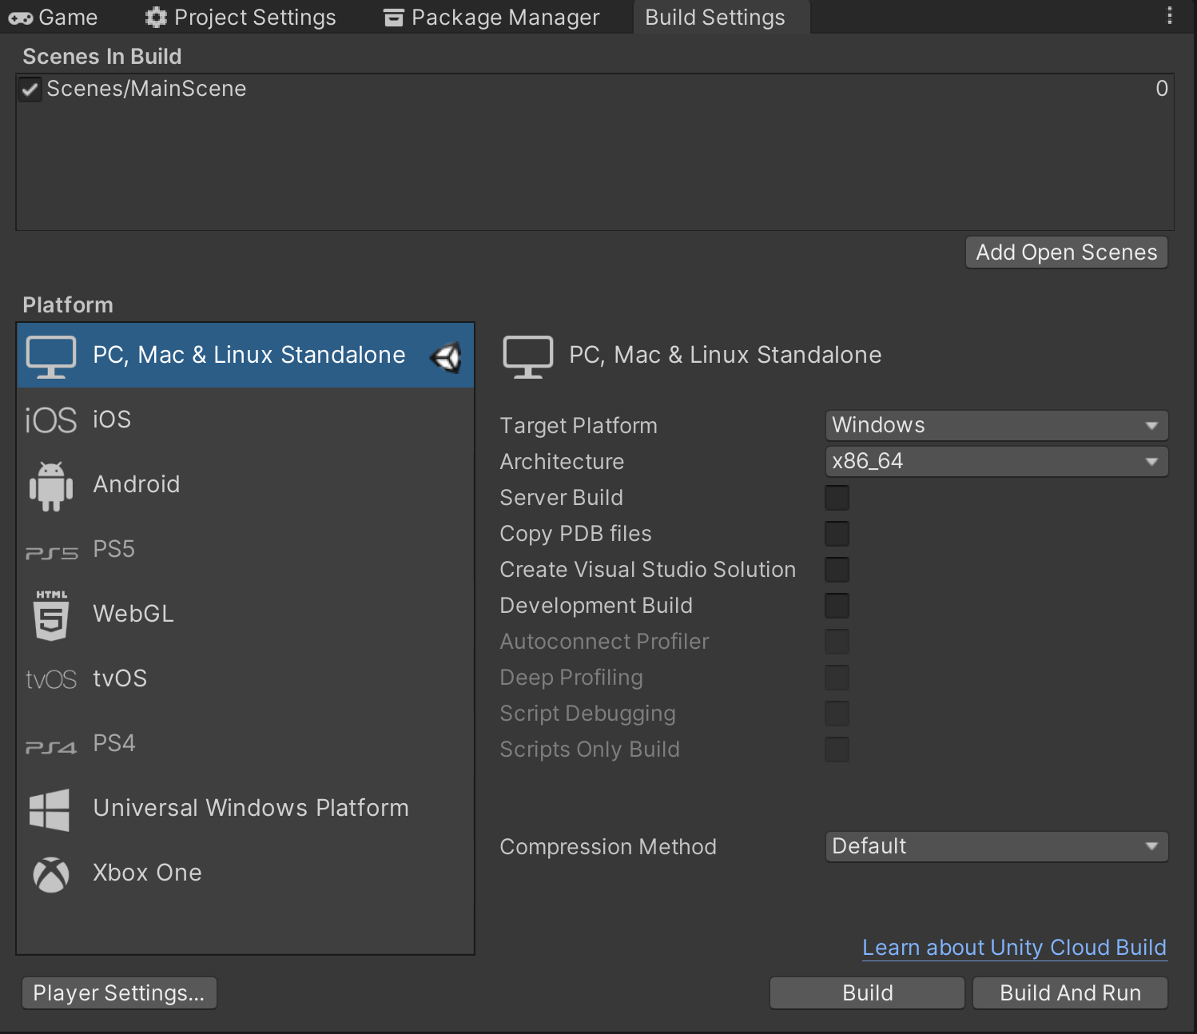
Standalone
Windows
Linux
Mac
Platform specific settings

Slide 8
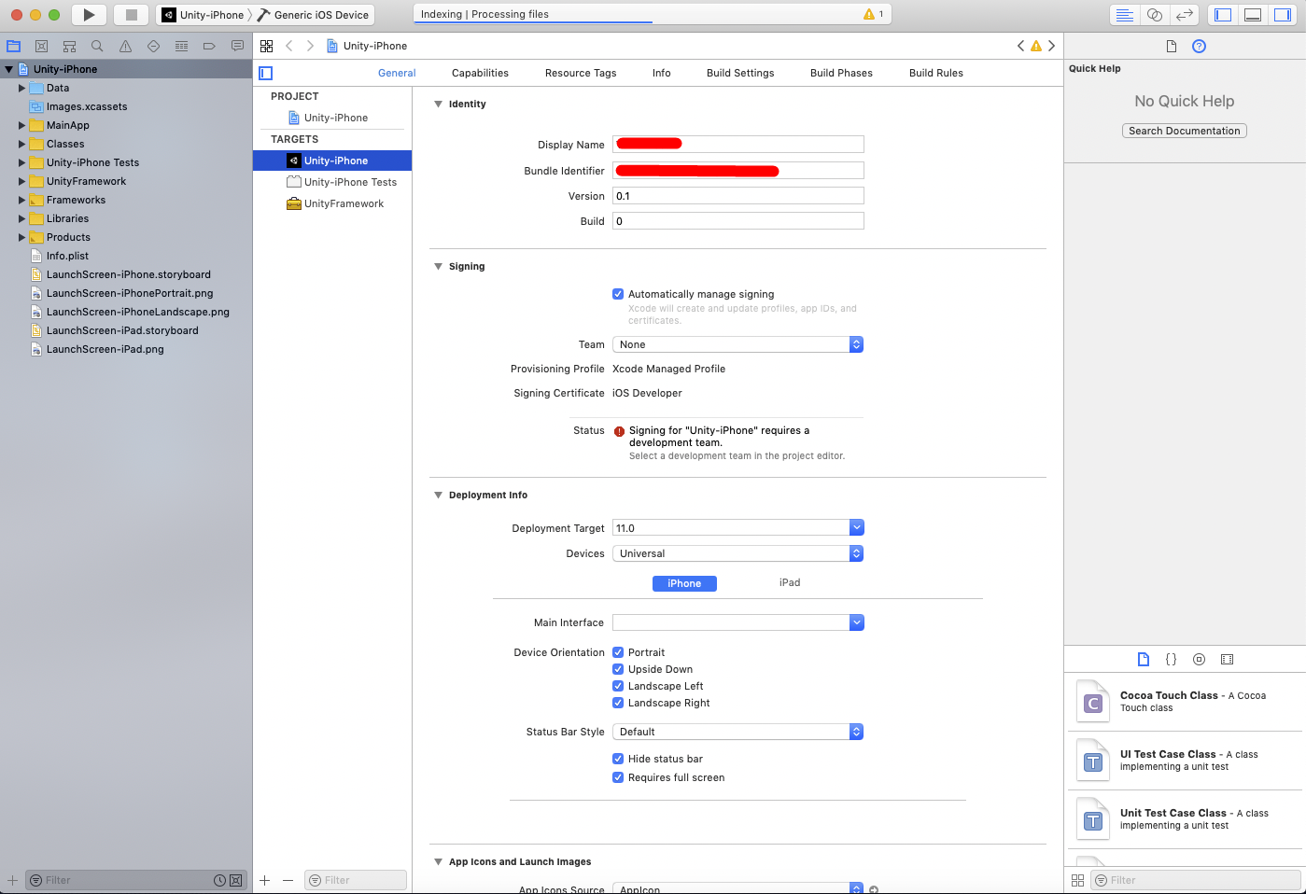
Mobile
Android
Debug - APK
Release - app bundle
Logcat from UPM
iOS
XCode project ----->
Platform specific settings

Slide 9
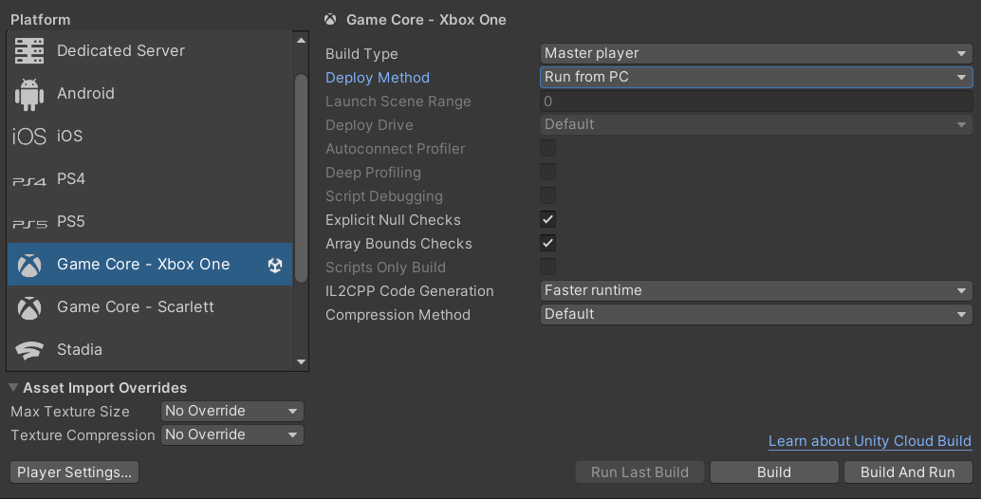
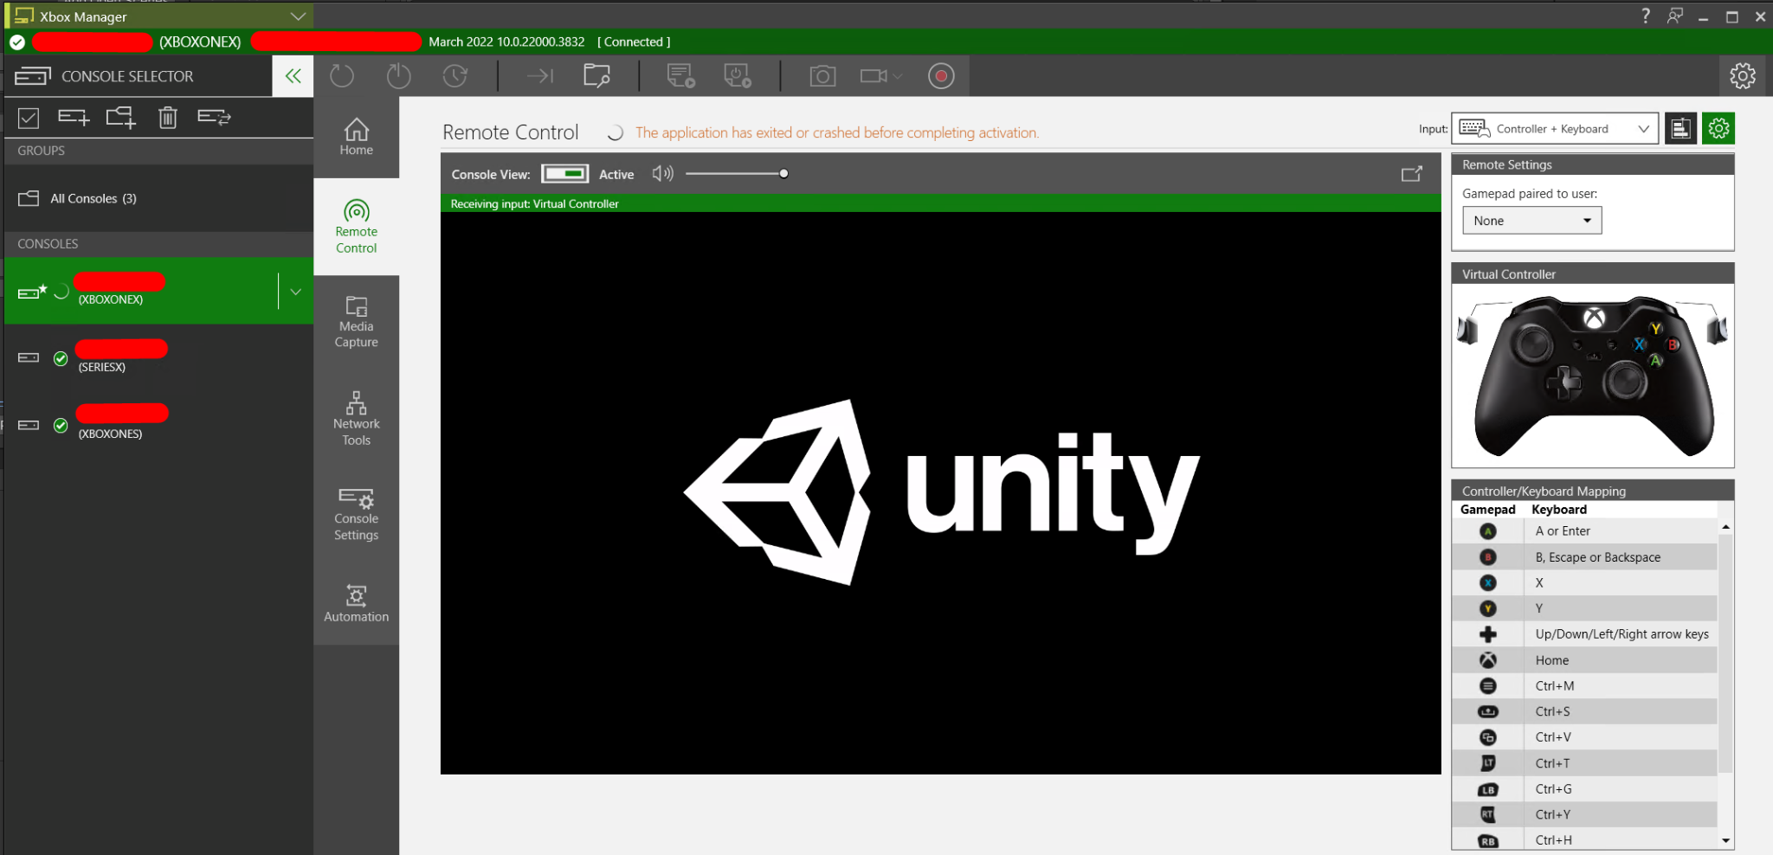
Consoles - Xbox One Series X
Get Microsoft developer account ($19)
Get a hardware (~$500)
Install Microsoft Xbox GDK
Install Unity3D GameCore - XboxOne addon
Build and run for target Xbox
Start Xbox One Manager (installed with GDK)

Slide 10
Useful Links
App Store Connect
Publish google app
Semantic versioning
Special Folders
Unity Build iOS
Platform Dependent Compilation

Slide 11

Summary
Preparing
Standalone
Windows
Linux
Mac
Mobile
iOS
Android
Consoles
Xbox Series X
Notes:
‹#›

Slide 12
Questions?
Email : dstrashilov@gmail.com
Notes:
‹#›

Slide 13












SoftUni Diamond Partners

Slide 14

License
This course (slides, examples, demos, exercises, homework, documents, videos and other assets) is copyrighted content
Unauthorized copy, reproduction or use is illegal
© SoftUni – https://about.softuni.bg
© Software University – https://softuni.bg
Notes:
‹#›

Slide 15
Trainings @ Software University (SoftUni)
Software University – High-Quality Education, Profession and Job for Software Developers
about.softuni.bg, softuni.org
Software University Foundation
softuni.foundation
Software University @ Facebook
facebook.com/SoftwareUniversity
Software University Forums
forum.softuni.bg
Notes:
‹#›

